Slide 1
Barnardos Boarded Out Practical Support Service For Adults

Slide 2
Barnardos have launched a new service
Boarded Out Practical Support Service for Adults
The focus of the service is to provide practical supports to individuals who were boarded out, nursed out , farmed out or fostered as children up to the 1991 Child Care Act
The Service has a national remit offering supports in person or over the phone
Self, family and professional referrals accepted
The Boarded out service is part of the larger Birth History service in Barnardos which provides support to adults who are illegal birth registrants, adopted adults or birth parents

Slide 3
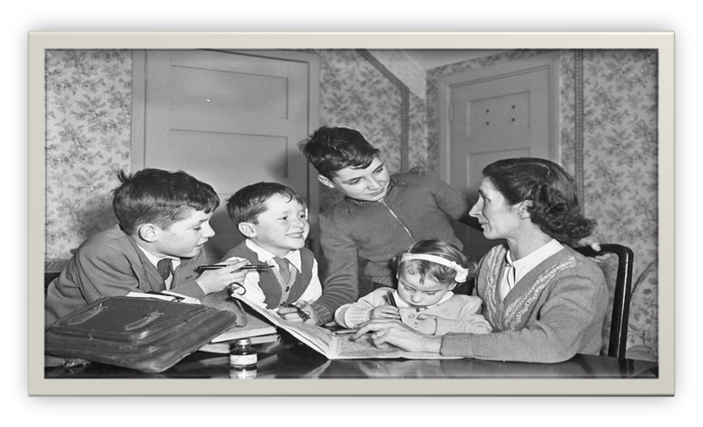
–
Boarded Out also referred to as fostered, farmed out, nursed out or at nurse
Was a system of care that existed in Ireland up until the 1990s where children were placed by the authorities with families other than their own
Some children lived with the family they were placed with throughout their childhood
For other children, it was a short term placement where children were nursed out to women or families and later sent to industrial schools
Older children were also sent from industrial schools to be boarded out or farmed out
Adoption only became legal in 1952.

Slide 4
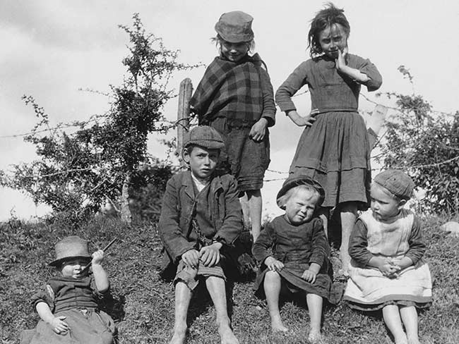
*Report Of the findings of the Consultation with Survivors of Mother and Baby Homes and County Homes, March - April 2021 Mary Lou O ’Kennedy OAK 17.05.2021
For some children, being boarded out gave them the opportunity to grow up within a family and experience positive family relationships
However, for other children, the experiences of been boarded out were traumatic and such experiences continue to impact individuals into their adult lives, in areas such as:
Trauma of early life separation from family of origin
Identity issues/lack of information about early life and family
Forced labour and exploitation
Abuse/neglect
Literacy issues/missed educational opportunities
Physical health issues and mental health issues
Isolation and loneliness
Stigmatisation and discrimination

Slide 5
Boarded Out Practical Support Service overview
The service is:
Free and confidential
Needs led and person centred
Open to anyone who was boarded out prior to Child Care Act 1991;
whether it was a long term or short term placement
whether the experience was a positive or negative placement
Practical supports include:
Accessing support services such as housing, mental health, physical health and social services
Coordinating social and community engagement and befriending
Advocacy and sign posting
Form filling – including support to apply for services through BIT Legislation
Work in conjunction with professionals and organisations within the community, statutory and voluntary sector to ensure the best outcome for the referred individual
Accessing Barnardos Therapeutic Supports

Slide 6
Referrals and Information
To refer to the Boarded Out service, please request a referral form from :
Dublin: Christchurch Square Dublin 8/ 23-24 and Buckingham Street, Dublin 1
Tel: (01) 8134100
Cork: Blackmore House, Meade Street, Cork
Tel: (021) 203800
Galway: The Sanctuary, 27 Chois Chlair, Claregalway
Tel: (091) 454489
Email: birthhistory@barnardos.ie
Webpage: Boarded Out Practical Support Service for Adults - Barnardos

Slide 7
Thank you

