Slide 1
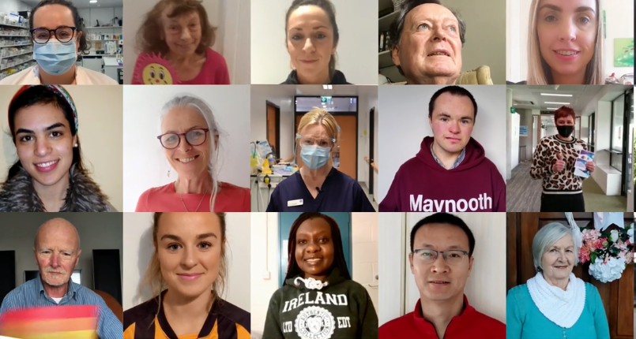
COVID-19 Vaccines
Partner Pack
May 2021
www.hse.ie

Slide 2
COVID-19 vaccination #ForUsAll
Over the coming weeks and months, everyone in Ireland who is eligible will be able to receive a free COVID-19 vaccine from the HSE.
The vaccine is bringing hope to our communities, reducing infections, illness and deaths among people who are vaccinated.
Getting your vaccine protects you, once you allow time for your vaccine work. When groups of people are vaccinated, this can protect the people around you too.
Over 1.6 million doses of the vaccine have been administered in Ireland and the more people who get vaccinated, the better it will be....for us all.
People aged 50-59 are currently being asked to register online for their Covid-19 vaccine and registration remains open for people aged 60 - 69. Up to date information on vaccine roll out and registration is available here.
People aged 65 years and older who live in long-term care facilities (Group 1), frontline healthcare workers (group 2), people aged 70 and older living in the community (group 3), people aged 16 to 69 who are at very high risk (group 4), people aged 65 to 69, including those at high risk (group 5 and 6), people aged 16 to 64 who are at high risk (group 7) continue to be vaccinated.
Appointments will take place in new HSE vaccination centres. Younger age groups will be invited to register online when it’s their turn.
Our aim in offering the vaccine to the population is to protect people and reduce the illness and deaths caused by this virus.
More Information
We encourage everyone to find answers to their questions from a trusted source, like the HSE website, our official social media channels, or the HSE’s HSElive information service on 1850 24 1850.

Slide 3
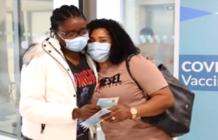
Advertising campaign updates
From 8 May we’re launching an
updated COVID-19 vaccine
campaign.
Watch the TV ad here.
The ad uses sunrise type light to
symbolise the hope the vaccination
programme brings .The ad contains messages on vaccine roll-out and safety and encourages people to visit hse.ie or call HSELive for information and to register when it’s their turn.
It features people of all ages
receiving their COVID-19 vaccine.
In the last frame of the ad
we show snapshots of a range
of people of all ages, filling the
screen, representing the real people of Ireland.
A special thanks to our
Stakeholder network for taking
the time to record
and send videos.
Organisations including; the National
Council for the Blind, GAA, LGFA,
WGPA, St. John of God Community
Services, The Irish Deaf Society, LGBT Ireland, Third Age Ireland, Pavee Point , The Irish Kidney Association, The Alzheimer’s Society and Senior Line asked their staff, volunteers and wider networks to record a short video. In addition the end frame shows front line health care workers including; the first health care worker to receive a vaccine, Bernie Waterhouse; nurses and pharmacists.

Slide 4
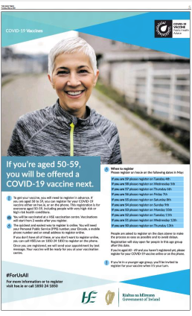
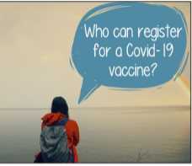
Advertising campaign updates
Other campaign elements:
Radio ads on local and national radio stations targeting the next eligible age group to register online for their vaccine.
National and local press ads targeting the next eligible age group to register online.
Social media , including twibbons ,paid search
Digital display and VOD advertising campaign live from week beginning May 10th
National leaflet drop to every household in Ireland in June with key COVID-19 vaccine information.
Badges distributed in COVID-19 vaccination centres

Slide 5
Social Posts, images and links
Why get the COVID-19 vaccine? Get it for yourself, your family, your friends and #ForUsAll #COVIDVaccines
COVID-19 vaccines are making a difference and protecting our communities. There are better days ahead #ForUsAll. For factual, expert information you can trust, visit: www.hse.ie/covidvaccine #COVIDVaccines
The more people that are vaccinated against COVID-19, the more protection we have. There are better days ahead #ForUsAll. For factual, expert information you can trust, visit: www.hse.ie/covidvaccine #COVIDVaccines
Get your COVID-19 vaccine when it’s your turn for yourself, your family, your friends and #ForUsAll For factual, expert information you can trust, visit: www.hse.ie/covidvaccine #COVIDVaccines
There are better days ahead #ForUsAll. Get your COVID-19 vaccine when it’s your turn for yourself, your family and your friends. For factual, expert information you can trust, visit: www.hse.ie/covidvaccine #COVIDVaccines
Links to include on social posts
Vaccine information: www.hse.ie/covid19vaccine
YouTube link to TV ad: https://youtu.be/k8GFqyjUgB8

Slide 6
COVID-19 Vaccines Information
Clear information helps us all to make an informed decision about the vaccine.
You can find factual, updated information about COVID-19 Vaccine on www.hse.ie/covid19vaccine.
You can phone our team in HSELive on
1850 24 1850 or 01 240 8787.
You can email HSElive at hselive@hse.ie
Remote sign language interpretation can be arranged by appointment.
Downloadable information materials on the vaccines are available on www.hse.ie/covid19vaccinematerials

Slide 7
Please share with your networks
Thank you

